Slide 1

Placement Hub
Placement Management System
TEAM MEMBERS:
2520030529-B.THRINADH
2520030532-CH.VIVEK
2520030055-J.POORNESH KUMAR

Slide 2

OVERVIEW
Abstract
Placement Hub is a DSA-based system designed to simplify and streamline college placements. It helps placement cells manage student profiles, company details, job opportunities, and recruitment drives in an organized manner.
Reduces manual effort and speeds up data access
Uses DSA for efficient searching, sorting, and filtering
Matches students with suitable roles based on skills and eligibility

Slide 3
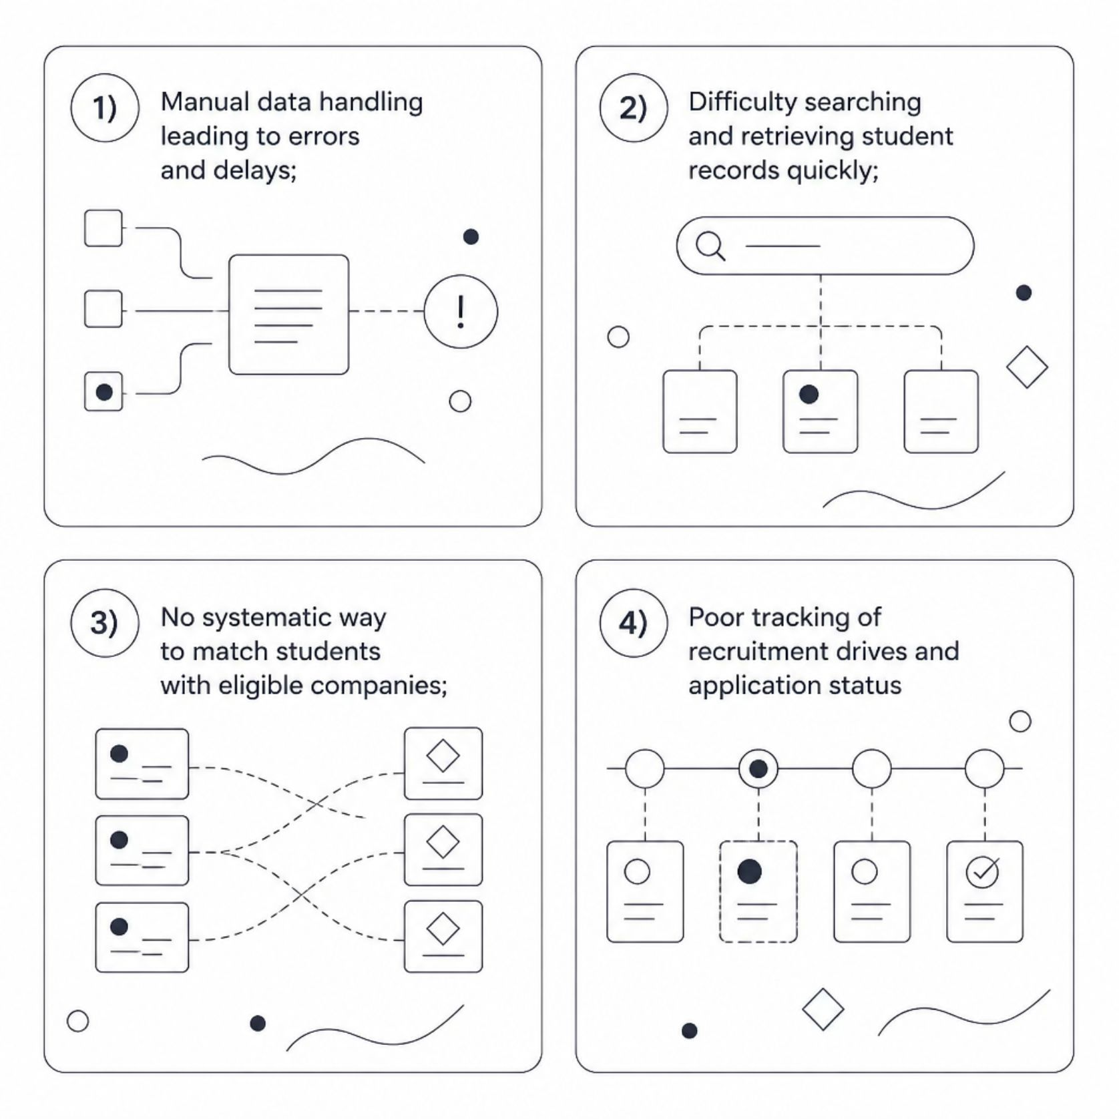
PROBLEM
The Problem We're Solving
Traditional placement processes rely on manual or unorganized methods — spreadsheets, paper records, and ad-hoc communication. This creates bottlenecks at every stage.
Searching through hundreds of student records is slow and error-prone
Identifying eligible candidates for a specific role is tedious
Tracking recruitment drives and application status lacks structure
There is a clear need for a system that uses DSA to organize, process, and retrieve placement data efficiently.

Slide 4
FEATURES
Proposed Functionalities
Student Management
Company & Job Profiles
Add, update, delete, and search student records. Store skills, qualifications, and application status.
Maintain company details, job roles, and eligibility criteria. Manage multiple recruitment drives.
Search & Filter
Smart Matching
Search and filter students by skills, CGPA, branch, or qualifications for targeted shortlisting.
Automatically match eligible students with suitable job opportunities based on defined criteria.
Sort & Organize
Status Tracking
Sort student and company records by various parameters for quick analysis and reporting.
Track application and placement status for every student across all active recruitment drives.

Slide 5

WORKFLOW
System Workflow
Student Data
Data Processing
Eligibility Match
Suitable Companies
The system processes raw student data through structured DSA operations, filters candidates based on eligibility, matches them to suitable companies, and tracks their placement status through to completion.

Slide 6
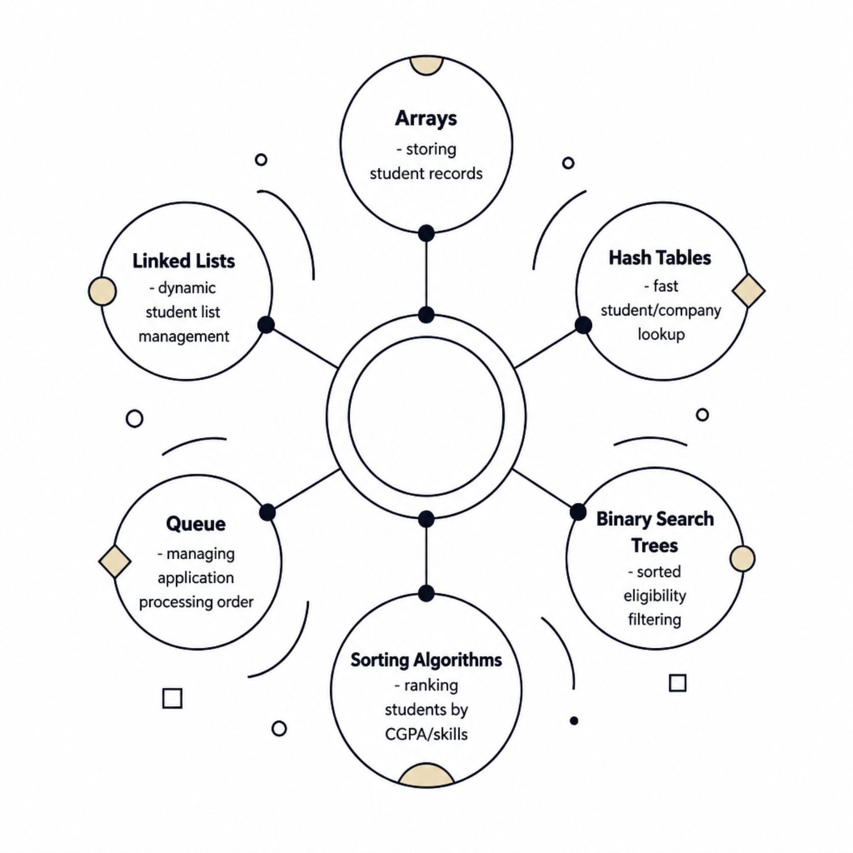
CORE DSA
How DSA Powers Placement Hub
Each data structure is chosen for a specific purpose within the system:
Arrays & Linked Lists — store and manage dynamic student/company records
Hash Tables — enable O(1) lookup for student roll numbers and company IDs
Binary Search Trees — support sorted filtering by CGPA, branch, or skills
Sorting Algorithms — rank students for shortlisting (Bubble, Insertion, Quick Sort)
Queues — manage application processing order in recruitment drives

Slide 7
TECH STACK
Tools & Technologies
Language
Core Concepts
Java
Data Structures & Algorithms
Data Structures
Algorithms
Arrays, Linked Lists, Stacks, Queues, Trees, Hash Tables
Searching, Sorting, Traversal, Matching
Environment
Storage
VS Code / Code::Blocks · Windows
File Handling or MySQL

Slide 8


OUTCOME
Expected Outcome
The final deliverable is a fully functional Placement Hub that demonstrates practical DSA application in a real-world scenario.
Reduces manual effort for placement administrators
Improves search, sort, and filter efficiency significantly
Accurately identifies eligible candidates for recruitment drives
Demonstrates practical use of hashing, trees, linked lists, and sorting
There was an error generating this image
This project bridges academic DSA concepts with a tangible, useful system for college placement cells.

Slide 9

Thank You
We appreciate your time and attention. We welcome your questions, feedback, and suggestions.
Project
Domain
Context
Placement Hub
Data Structures & Algorithms
College Placement Management

